Slide 1


Electronic Safe Using Arduino
INTERNET OF THINGS
Dr. Divya Rani.Prof-CSE

Slide 2

Team members
G.CHETHAN REDDY
-Lead
20201COD0015
M.KESAVA
20201CEI0164
HARITEJA
20201COD0012
20201COD0028
20201COD0016
P.SIVA RAMI REDDY
P.DINESH

Slide 3

Overview
project involves building an electronic safe that uses an Arduino Uno, a micro servo, resistors, an LCD, and a keypad. The safe will be designed to allow users to input a code and then unlock the safe using a servo motor. The project will involve planning and research, selecting and ordering components, assembling and testing the safe, debugging and troubleshooting, and final testing and refinement.

Slide 4
OBJECTIVES
To learn how to use Arduino Uno and various electronic components
To develop skills in coding and programming
To build a functional and secure electronic safe
To gain experience in project management, including planning, testing, and troubleshooting
To develop problem-solving skills and critical thinking.
Outcomes
Understanding of how to use Arduino Uno and various electronic components
Development of skills in coding and programming
Creation of a functional and secure electronic safe
Improved project management skills, including planning, testing, and troubleshooting
Improved problem-solving skills and critical thinking
Enhanced creativity and innovation skills

Slide 5
CHALLENGES FACED
There are several challenges that can be faced when using a smart pet feeder, including:
Hardware Compatibility: Not all components are compatible with each other, and some may require additional hardware or software libraries to work correctly with the Arduino Uno. So we decided to do research on compatibility of each component before purchasing them.
Mechanical Design: Building a physical safe that can accommodate all the components can be challenging.

Slide 6

Security Concerns: An electronic safe is only as secure as its code and physical design. So we should choose a strong combination and ensure the safe is designed to resist tampering and forced entry.
Time Management: Building a project like an electronic safe can take time, especially if we encounter any issues with hardware or code. So we should plan your time accordingly.
Above mentioned challenges are just imagined as these phase is just like feasibility study we may face many other challenges but we will make sure that will cross all the challenges
By taking help from our respected “DIVYA maam”.

Slide 7
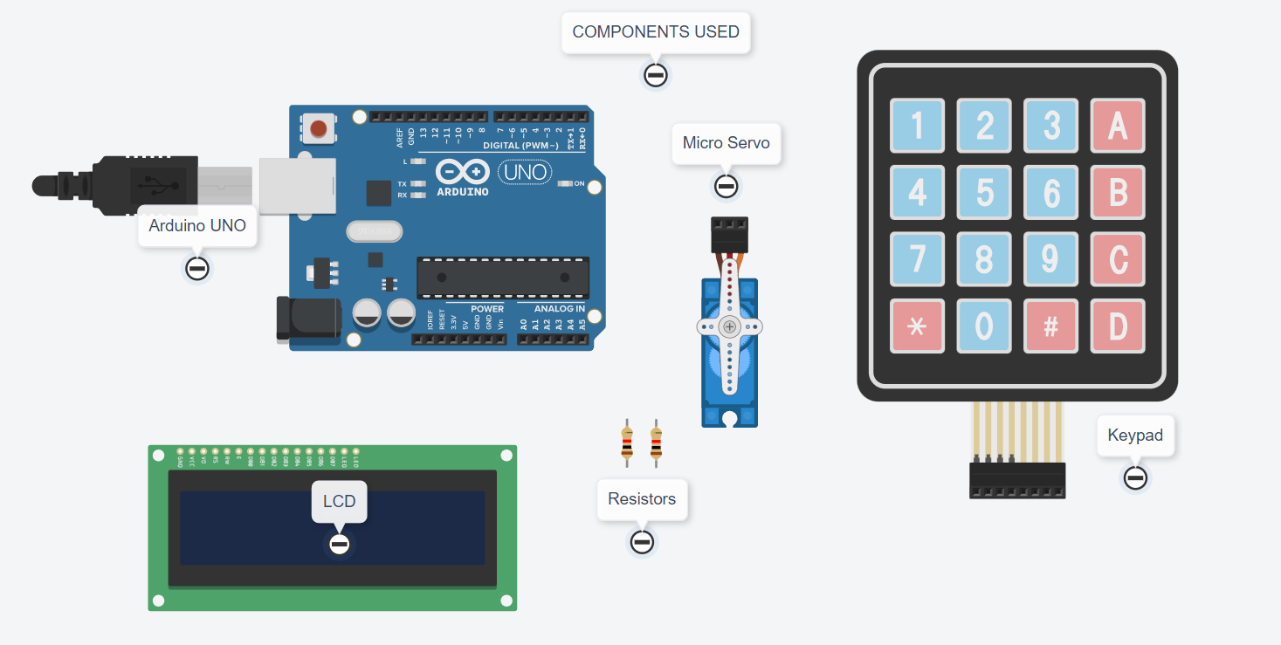
COMPONENTS USED IN PROJECT

Slide 8
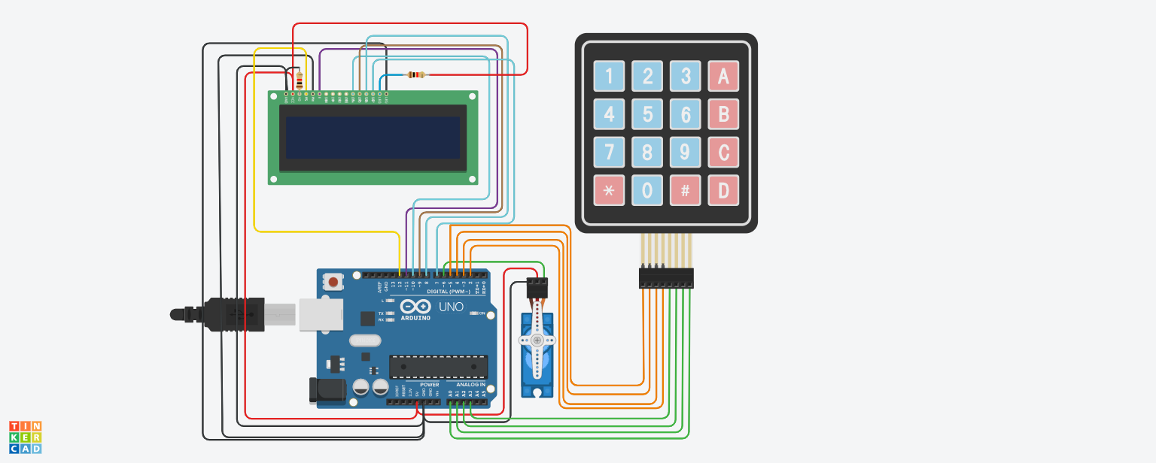

Slide 9


Project Timeline
Phase1- Feasibility Study:which involves,coming together and making team,selecting project, calculating finance for our project,and finally gathering all the components.
Phase2-DESIGN AND CODING:which involves preparing the design for our project model and assembling all the components and finally coding according to our project
Phase3-TESTING AND PRESENTATION:Which involves performing some rounds of tests to ensure our project get succeeded,and finaly presenting our project.

Slide 10

CONCLUSION
In an ever-changing world, technological advances can work to our advantage or disadvantage, and this is certainly true when it comes to modern features and security safes.
Here is the One of the best things about an electronic lock is how easy it is to open your safe. If you are faced with an emergency situation and need to get into your safe immediately, your electronic lock is usually more reliable speed-wise than a traditional mechanical locking system.

Slide 11


